Slide 1
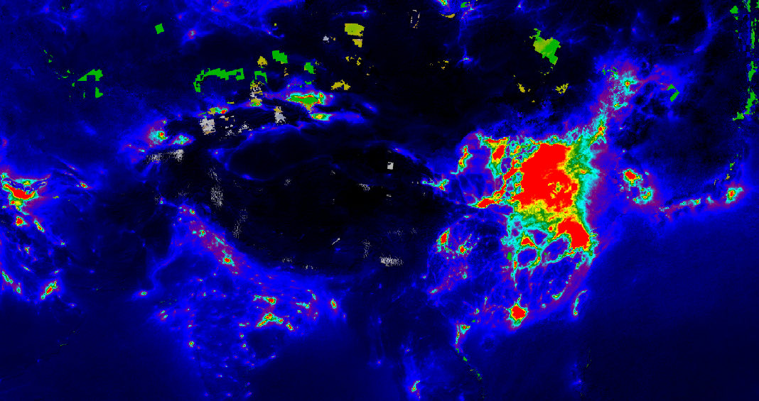
Machine Learning of NO2 emissions classification in Google Earth Engine
Anna Pavlenko
May 6, 2020

Slide 2
Overview
- Summarize the main plans:
- Data set available
- Methods used
- Validation of result
- Explain the long-term course to follow
- Look for the best methods of Machine
Learning

Slide 3
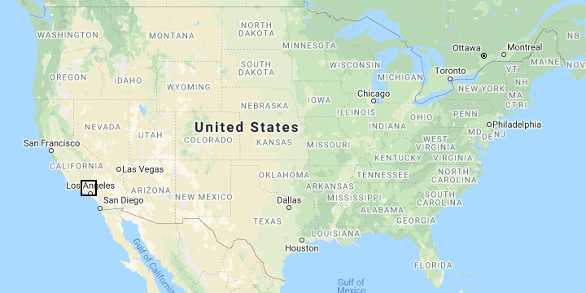
Study Area: US, Los Angeles

Slide 4
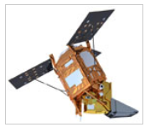
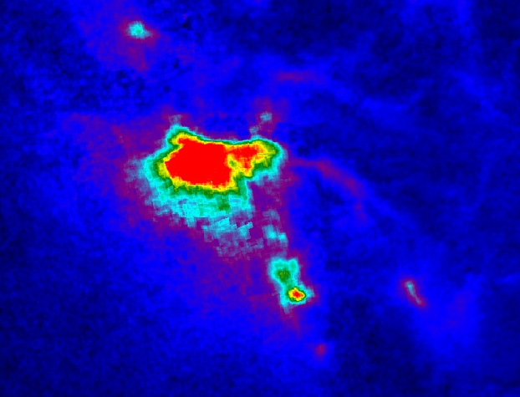
Sentinel-5P
Launched 13 October 2017 by the ESA to monitor air pollution
The TROPOspheric Monitoring Instrument (TROPOMI) instrument.
Los Angeles, US
OFFL/L3_NO2:
. FilterDate
('2019-12-01', '2019-12-31')

Slide 5
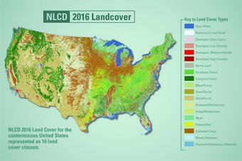
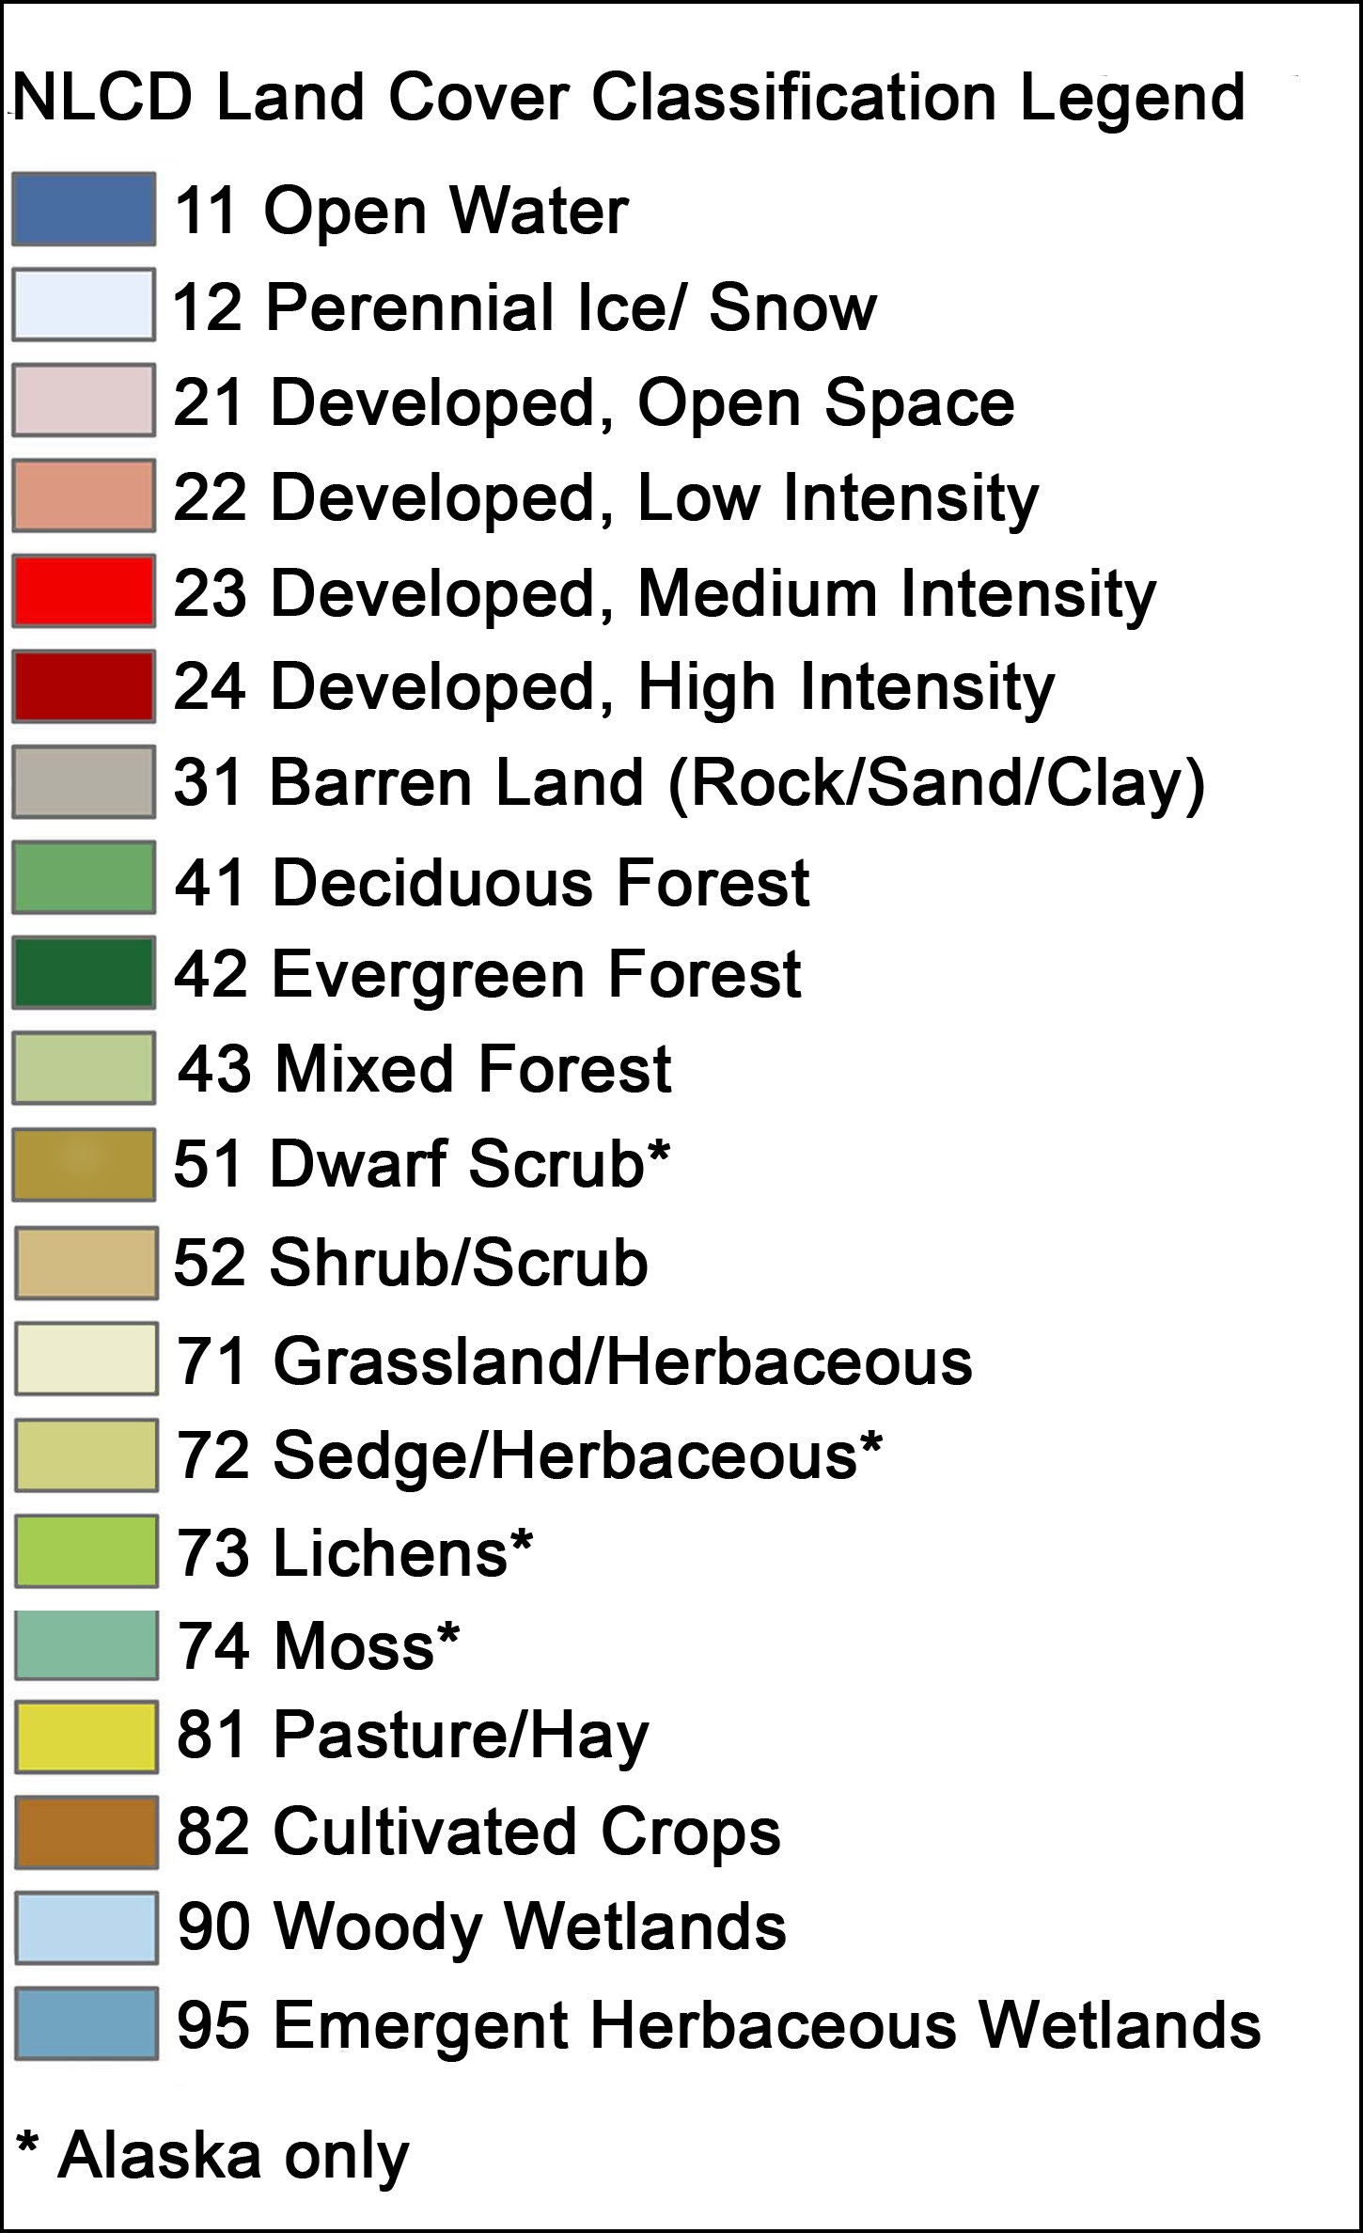
National Land Cover Database (NLCD)

Slide 6
LANDSAT 8 and Power Plants
Data Set

Slide 7
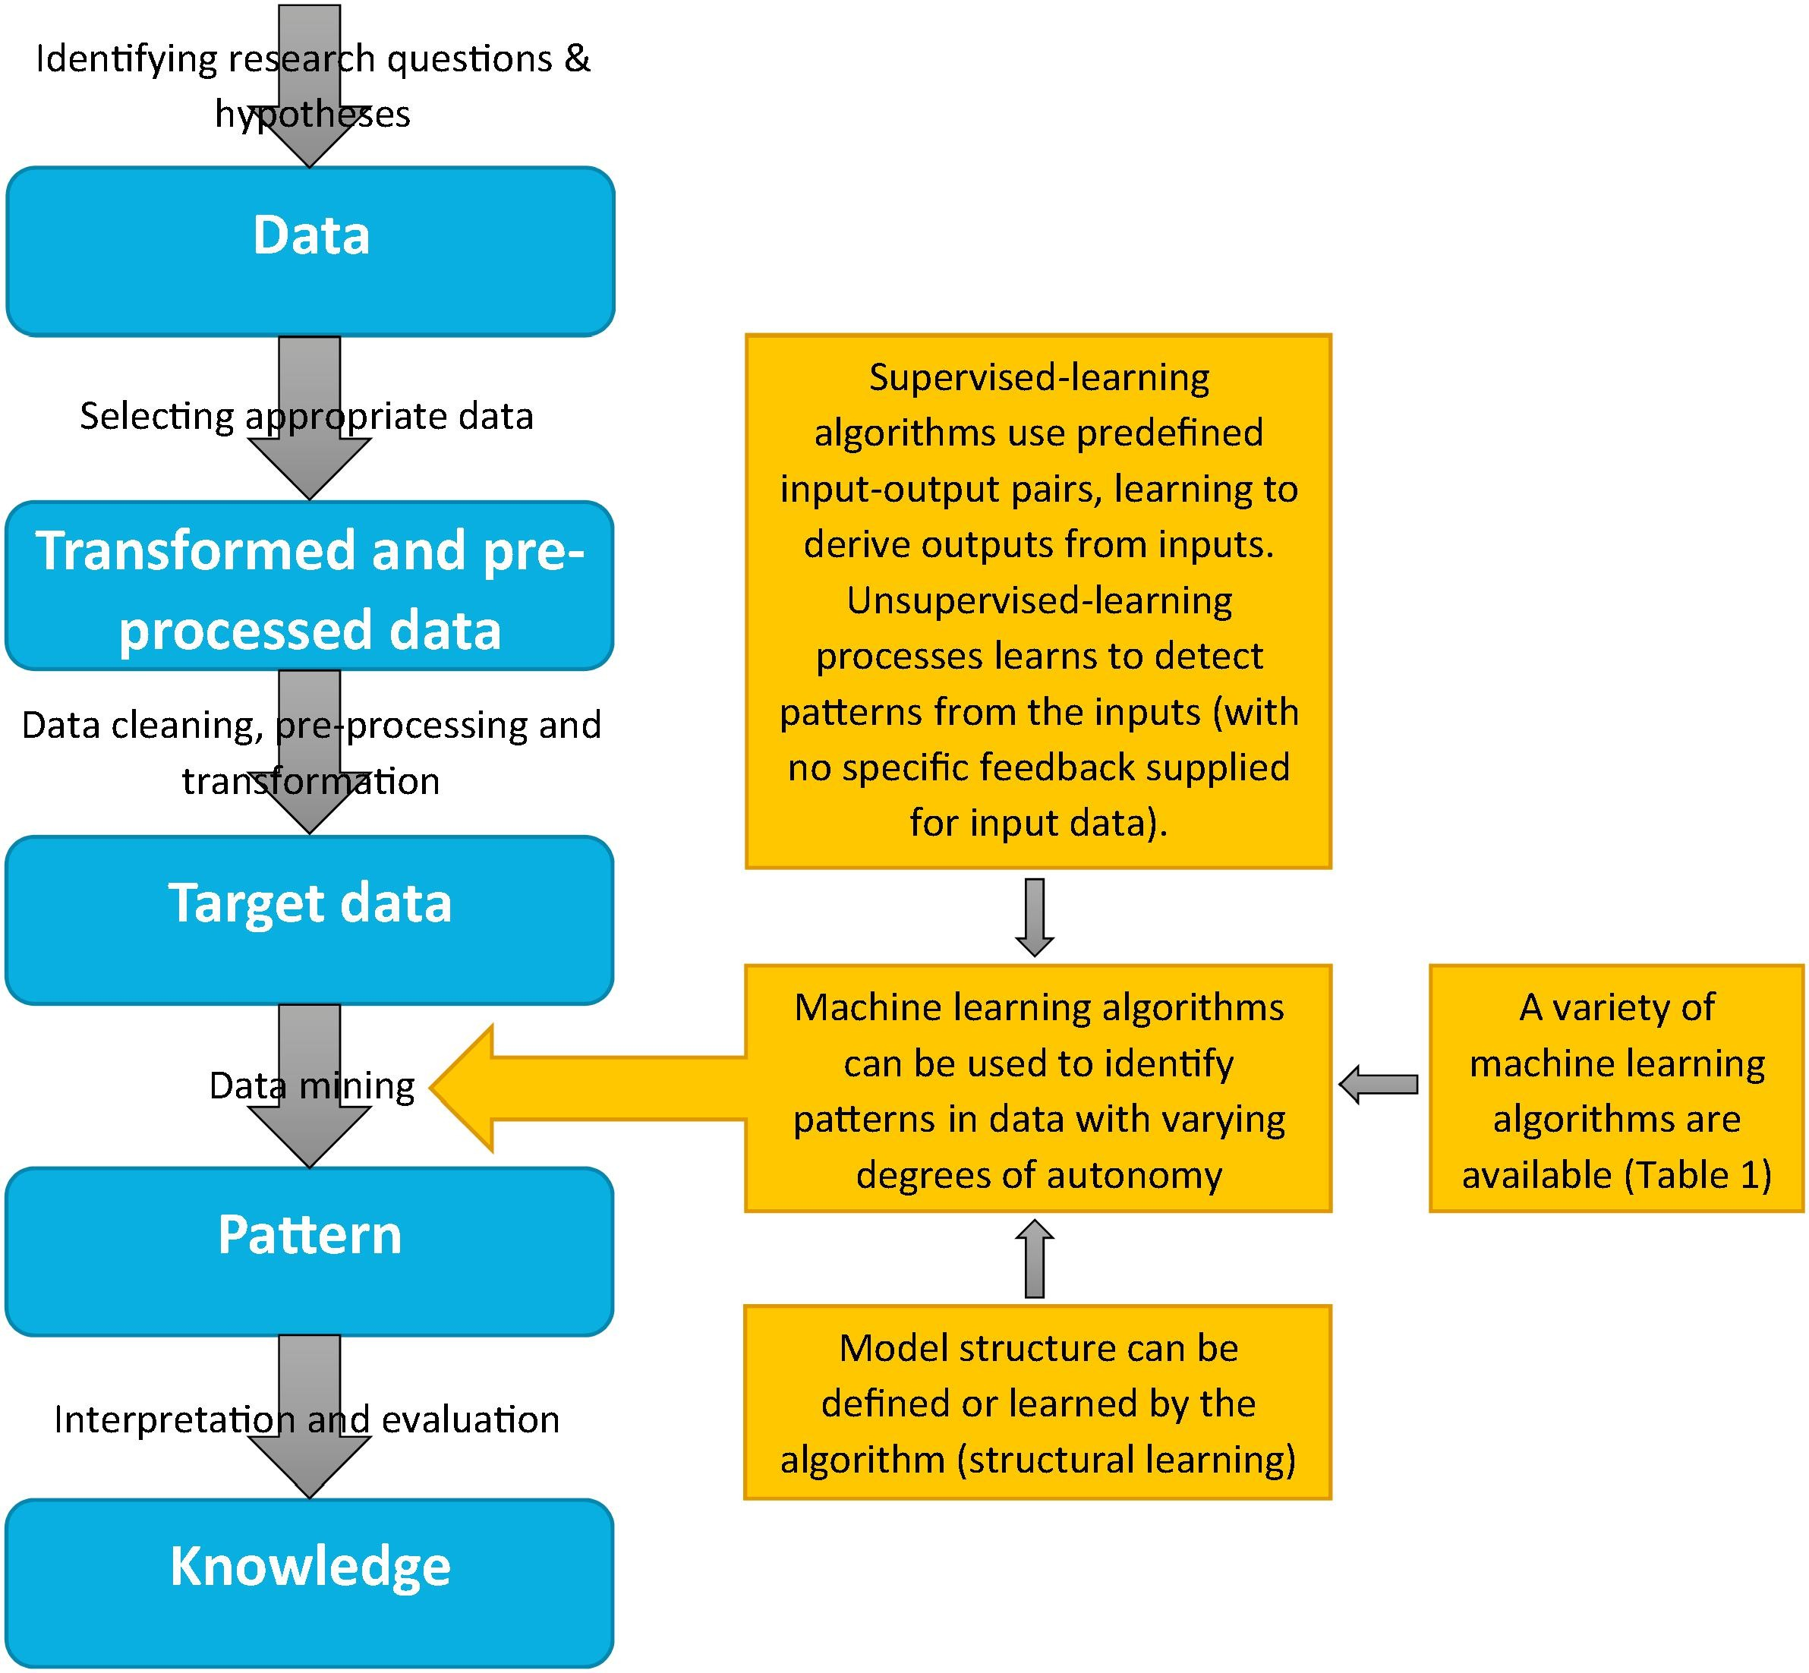
Remote Sensing Interpretation

Slide 8
Machine Learning in Earth Engine
I. EE API Methods
II. Export/Import functions for TFRecord files
ee.Classifier
Supervised
Classification
Unsupervised
Classification
Regression
spectral
un-mixing
ee.Clusterer
ee.Reducer
ee.Model package

Slide 9
Classifiers Overview in this Project:
Machine learning techniques for Supervised classification (Random Forest Method)
Machine learning techniques for Unsupervised classification (Kmean)
The advanced analysis: spectral Un-mixing
(ee.Reducer)

Slide 10
Supervised Classification
1) Creating an ROI from coordinates
2) Loading an ImageCollection and filtering to a single image
3) Collect Training Data
4) Sample Imagery at Training Points to Create Training datasets
5) Train the classifier
6) Classify the Image & Display the Results
7) Assess the Accuracy (confusionMatrix)

Slide 11
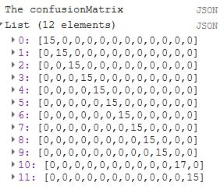
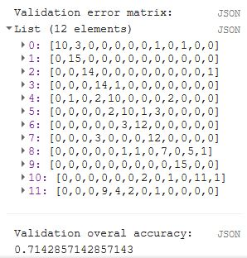
Supervised Classification

Slide 12
Unsupervised Classification
(clustering)
1. Assemble features with numeric properties in which to find clusters.
2. Create a clusterer. Set its parameters if necessary.
3. Train the clusterer using the training data.
4. Apply the clusterer to an image or feature collection.
5. Label the clusters.

Slide 13
Unsupervised Classification
(clustering)

Slide 14
The advanced analysis:
Spectral Un-mixing

Slide 15
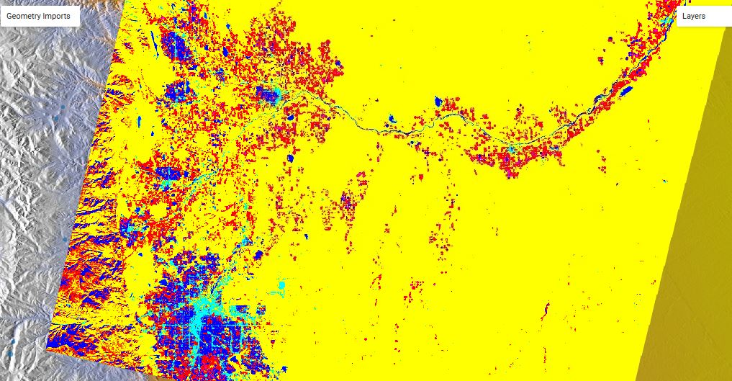
Result of Un-mixing on
Denver Area

Slide 16
Development in the future
1) Consider 1 Year Time Frame for
Landsat / Tropi Data in EE.
2) Set a Training Data Set from NAIP
imagery (high resolution)
3) Work on Deep Machine Learning -
TensorFlow model

Slide 17
Long-term goal
Build Machine Deep Learning Project:
- Creating a TensorFlow Deep Learning VM
Instance
- Accuracy validation the TensorFlow compared to Supervised/ Unsupervised Classification

